Slide 1
ONE-CLASS CLASSIFICATION
Theme presentation for CSI5388
PENGCHENG XI
Mar. 09, 2005

Slide 2
papers
D.M.J. Tax, One-class classification; Concept-learning in the absence of counter-examples, Ph.D. thesis Delft University of Technology, ASCI Dissertation Series, 65, Delft, 2001, June 19, 1-190.
B.Scholkopf, A.J. Smola, and K.R. Muller. Kernel Principal Component Analysis. In B.Scholkopf, C.J.C. Burges, and A.J. Smola, editors, advances in Kernel Methods-SV learning , pp.327-352. MIT Cambridge, MA, 1999.

Slide 3
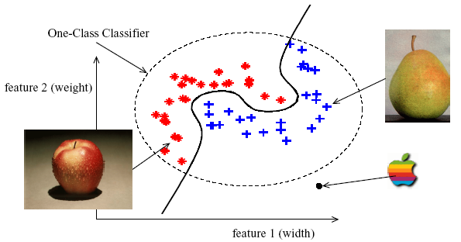
Difference (1)

Slide 4
Difference (2)
Only information of target class (not outlier class) are available;
Boundary between the two classes has to be estimated from data of only genuine class;
Task: to define a boundary around the target class (to accept as much of the target objects as possible, to minimizes the chance of accepting outlier objects)

Slide 5
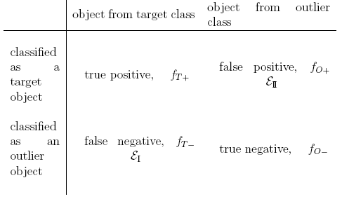
Situations

Slide 6
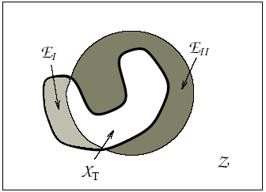
Regions in one-class classification
(Tradeoff? )Using a uniform outlier distribution also means that when EII is minimized, the data description with minimal volume is obtained. So instead of minimizing both EI and EII, a combination of EI and the volume of the description can be minimized to obtain a good data description.

Slide 7



considerations
A measure for the distance d(z) or resemblance p(z) of an object z to target class
A threshold on this distance or resemblance
New objects are accepted:
or

Slide 8

Error definition
A method which obtains the lowest outlier rejection rate, , is to be preferred.
For a target acceptance rate , the threshold is defined as:

Slide 9
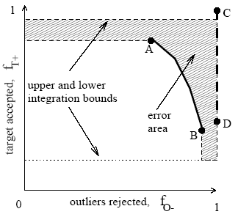
ROC curve with error area (evaluation?)

Slide 10

1-dimensional error measure
Varying thresholds along A to B:
not on the basis of one single threshold, but integrates their performances over all threshold values

Slide 11
Characteristics of one-class approaches
Robustness to outliers:
* when in a method only the resemblance or distance is optimized, it can therefore be assumed that objects near the threshold are the candidate outlier objects.
* for methods where resemblance is optimized for a given threshold, a more advanced method for outliers should be applied in the training set.

Slide 12
Characteristics of one-class approaches (2)
Incorporation of known outliers:
general idea: to further tighten the description
Magic parameters and ease of configuration:
parameters→ have to be chosen beforehand as well as their initial values
“magic”→ having a big influence on the final performance and no clear rules are given how to set them

Slide 13
Characteristics of one-class approaches (3)
Computation and storage requirements:
training is often done off-line→ training costs are not that important
to adapt to changing environment→ training costs are important

Slide 14
Three main approaches
Density estimation
Gaussian model, mixture of Gaussians and Parzen density estimators
Boundary methods
k-centers, NN-d and SVDD
Reconstruction methods
k-mean clustering, self-organizing maps, PCA and mixtures of PCA’s and diabolo networks

Slide 15
Density methods
Straightforward method: to estimate the density of the training data and to set a threshold on this density
Advantageous when: a good probability model is assumed; and the sample size is sufficient
Rule of accepting: By construction, only the high density areas of the target distribution are included

Slide 16
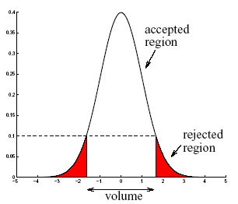
Density methods→ Gaussian model

Slide 17


Gaussian model (2)
Probability distribution for a d-dimensional object x is given by:
Insensitivity to scaling of the data: utilizing the complete covariance structure of the data
Another advantage: computing the optimal threshold for a given :

Slide 18

Density methods→
Mixture of Gaussians
Due to strong requirements of the data: unimodal and convex
To obtain a more flexible density model: a linear combination of normal distributions
Number of Gaussians is defined beforehand; means and covariance can be estimated

Slide 19

Density methods→
Parzen density estimation
Also an extension of Gaussian model:
equal width h in each feature direction means to assume equally weighted features and thus to be sensitive to the scaling of the feature values of the data
Cheap training cost, but expensive testing cost: all training objects have to be stored and distances to all training objects have to be calculated and sorted

Slide 20

Boundary methods→ K-centers
General idea: covers the dataset with k small balls with equal radii
To minimize:
(maximum distance of all minimum distances between training objects and the centers)

Slide 21

Boundary methods→ NN-d
Advantages: avoids density estimation and only uses distances to the first nearest neighbor
Local density is estimated by:
a test object z is accepted when: its local density is larger or equal to the local density of its nearest neighbor in the training set

Slide 22
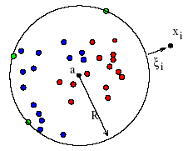
Support Vector Data Description
To minimize structural error:
with the constraints:

Slide 23
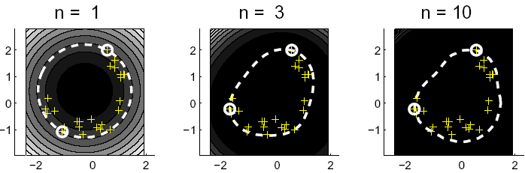
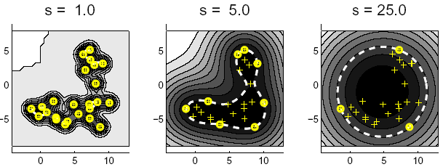
Polynomial VS Gaussian kernel

Slide 24
Prior knowledge in reconstruction
reconstruction method: In some cases, prior knowledge might be available and the generating process for the objects can be modeled. When it is possible to encode an object x in the model and to reconstruct the measurements from this encoded object, the reconstruction error can be used to measure the fit of the object to the model. It is assumed that the smaller the reconstruction error, the better the object fits to the model.

Slide 25
Reconstruction methods
Most of the methods make assumptions about the clustering characteristics of the data or their distribution in subspaces
A set of prototypes or subspaces is defined and a reconstruction error is minimized
Differs in: definition of prototypes or subspaces, reconstruction error and optimization routine

Slide 26

K-means
Assume that data is clustered and can be characterized by a few prototype objects or codebook vectors
Target objects are represented by the nearest prototype vector measured by Euclidean distance
Placing of prototypes is optimized by minimizing the error:

Slide 27
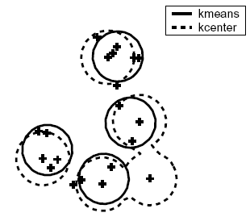
K-means V.S. K-center
K-center: focus on worst-case objects
K-means: more robust to remote outliers

Slide 28
Self-Organizing Map (SOM)
Placing of prototypes is optimized with respect to data, and constrained to form a low-dimensional manifold
Often a 2- or 3-dimensional regular square grid is chosen for this manifold
Higher dimensions are possible, but expensive storage and optimization costs

Slide 29
Principal Component Analysis
Used for data distributed in a linear subspace
Finds the orthonormal subspace which captures the variance in the data as best as possible
To minimize the square distance from the original object and its mapped version:

Slide 30
Kernel PCA
Can efficiently compute principal components in high-dimensional feature spaces, related to input space by some nonlinear map
Indistinguishable problems in original spaces can be distinguished in mapped feature space with the map
The map need not to be obviously defined because of inner products can be reduced to kernel functions

Slide 31
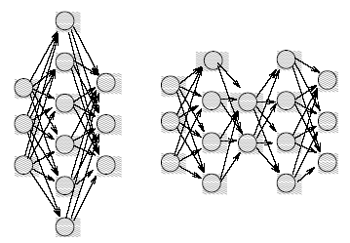
Auto-encoders and Diabolo networks
(bottleneck layer)
auto-encoder network diabolo network

Slide 32
Auto-encoders and Diabolo networks
Both are to reproduce the input patterns at their output layer
Differs in: number of hidden layers and the sizes of the layers
Auto-encoder tends to find a data description which resembles the PCA; while small number of neurons in the bottleneck layer of the diabolo network acts as an information compressor
When the size of this subspace matches the subspace in the original data, the diabolo network can perfectly reject objects which are not in the target data subspace

